Slide 1

CRIME PREDICTION ANALYSIS
Prepared By
KARTHIKEYAN R

Slide 2
Table of contents
INTRODUCTION
OBJECTIVE
PROBLEM STATEMENT
PROCESS INVOLVED IN PROJECT
EXPLORATORY DATA ANALYSIS
ILLUSTRATION OF SOME PLOTS
MODEL SELECTION
MODELS DESCRIPTION
CONCLUSION

Slide 3
Introduction
Crime Prediction analysis is a systematic approach for identifying and analyzing patterns and trends in crime. Our system can predict regions which have high probability for crime occurrence and can visualize crime prone areas.
Crime data analysts can help the Law enforcement officers to speed up the process of solving crimes. Using the concept of data mining we can extract previously unknown, useful information from an unstructured data. Here we have an approach to develop a data mining procedure that can help solve crimes faster.

Slide 4
Objective
The main objective of the project is to predict the crime rate and analyze the crime rate to be happened in future. Based on this Information the officials can take charge and try to reduce the crime rate.
Crime analysis based on available information to extract crime patterns. Using various multi linear regression techniques, frequency of occurring crime can be predicted based on territorial distribution of existing data and Crime recognition.
The system will look at how to convert crime information into a regression problem, so that it will help detectives in solving crimes faster.

Slide 5
Problem Statement
Crimes now days are increasing day by day and with different level of intensity. The result is great loss to society in terms of monitory loss, social loss and further it enhances the level of threat against the smooth livelihood in the society. To overcome this problem the computing era can help to reduce the crime or even may be helpful in predicting the crime so that sufficient measures can be taken to minimize the loss to property and life.
The crime rate prediction strategies can be applied on historical data available in the police records by examining the data at various angles like reason of crime, frequency of similar kind of crimes at specific location with other parameters to prepare model the crime prediction. It is the major challenge to understand the versatile data available with us then model it to predict the future incidence with acceptable accuracy and further to reduce the crime rate.

Slide 6
Process involved in project
Data Gathering
Data Preprocessing
Splitting train and test data
Choosing the model
Training data
Testing data
Prediction

Slide 7
Exploratory Data Analysis
Exploratory Data Analysis (EDA) is an approach to analyze the data using visual techniques. It is used to discover trends, patterns, or to check assumptions with the help of statistical summary and graphical representations.
In Exploratory Data Analysis we will be dealing with the Data Cleaning and describing the data.
Then visualizing the data shows the range between the rows and columns that are taken in the data. Through EDA we can predict the crime.

Slide 8
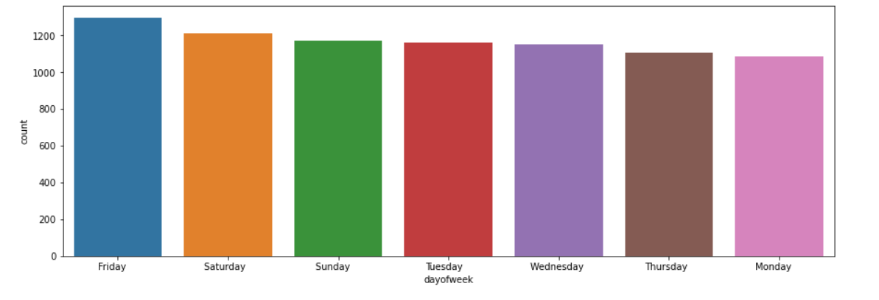
Illustration of some plots

Slide 9
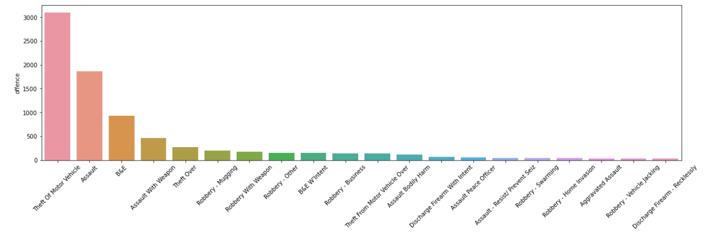

Slide 10
Model Selection
LOGISTIC REGRESSION
Logistic Regression is a supervised learning technique that uses a machine earning algorithm. It’s a method for predicting a categorical dependent variable from a set of independent variables.
The output of a categorical dependent variable is predicted by logistic regression, and the outcome must be acategorical value

Slide 11
RANDOM FOREST CLASSIFIER
Random forest is a classification algorithm consisting of many decisions trees.
It uses bagging and feature randomness when building each individual tree to try to create an uncorrelated forest of trees whose prediction by committee is more accurate than that of any individual tree.
BAGGING CLASSIFIER
A Bagging classifier is an ensemble metaestimator that fits base classifiers each on random subsets of the original dataset and then aggregate their individual predictions (either by voting or by averaging) to form a final prediction

Slide 12
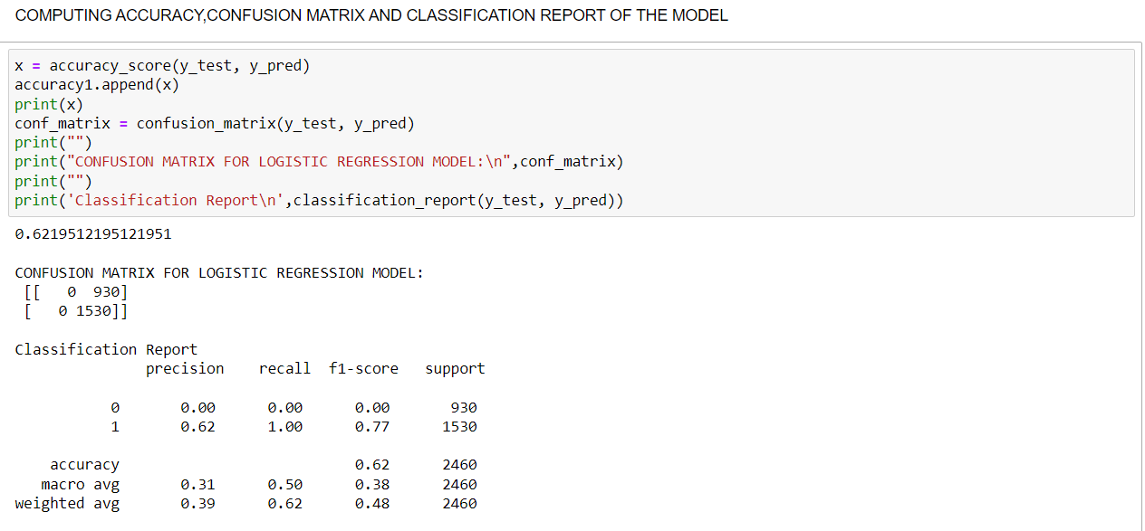
Model 1: Description LOGISTIC REGRESSION

Slide 13
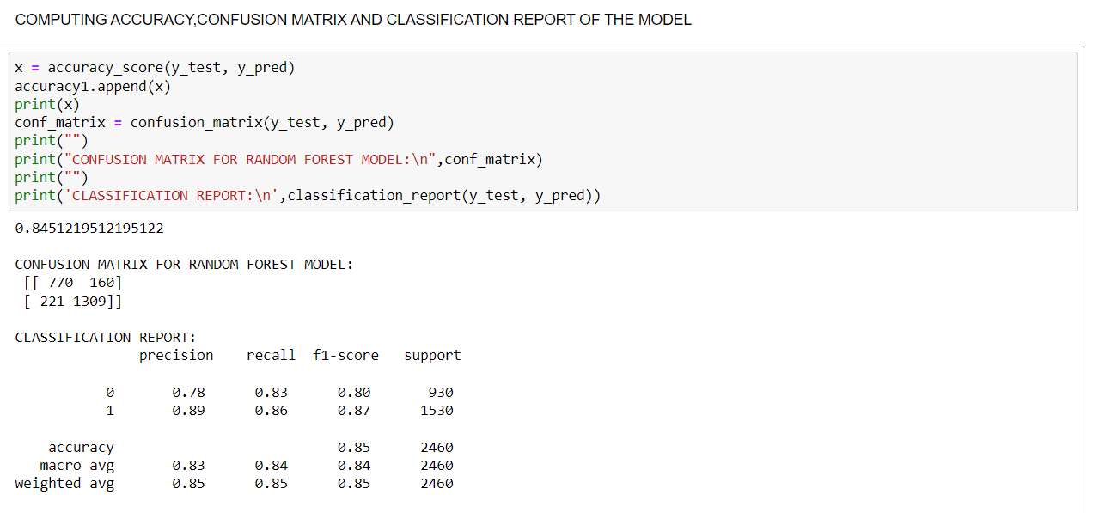
Model 2 : Description RANDOM FOREST CLASSIFIER

Slide 14
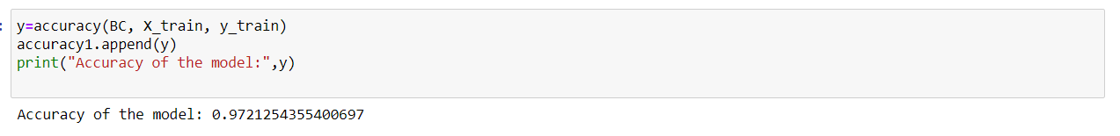
Model 3 : Description BAGGING CLASSIFIER

Slide 15
Conclusion
The purpose of this study is to examine crime analysis through the applicability of data mining methods in the process of crime prediction.
The results of experiments conducted in this research by implementing algorithms of data mining methods have revealed that these methods are applicable in the process of crime prediction.
The use of machine learning and data mining in crime analysis is important because data mining methods can be used in the decision making process. Decision making is very important in crime prevention in order to decide accurate actions and law enforcement strategies.

Slide 16


